Slide 1
Agriculture and Food and Nutrition Security: Climate Risk and challenges
Making Useful Climate information Available for ALL
Peter Johnston
Climate System Analysis Group
University of Cape Town

Slide 2
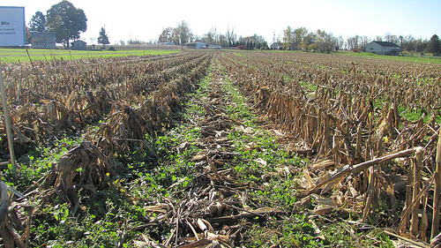
Climate-related disasters (including droughts, floods and storms) are among the main drivers of food insecurity.

Slide 3
Climate Variability Considerations
Cycles of wet and dry/warm and cool
Seasonal shifts
Dry spells
Global forcings - El Niño /La Niña
Extremes - Droughts and floods
Pests/ Diseases
Market/price fluctuations
Vulnerability depends on resilience, resilience depends on infrastructure and capacity

Slide 4
Climate Change Considerations
Climate variability has a direct influence on food production…drought/flood/heat waves
Increased temperatures are virtually certain
Changes in rainfall patterns/seasonal shifts, intensity, and increasing variability
Vulnerability depends on resilience, resilience depends on infrastructure and capacity
Climate change increases uncertainty and exposure to risk

Slide 5
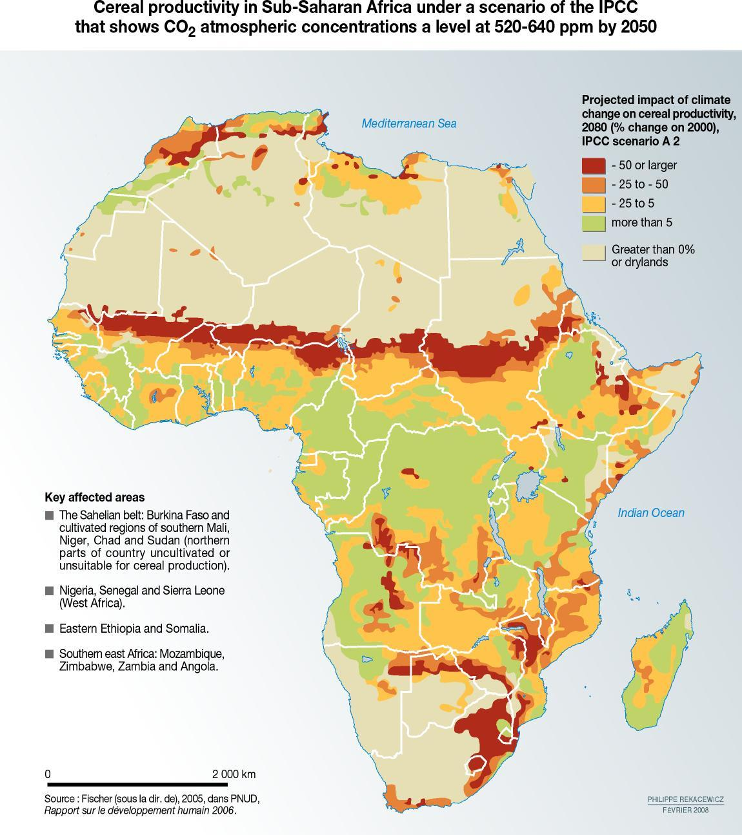
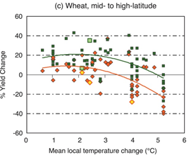
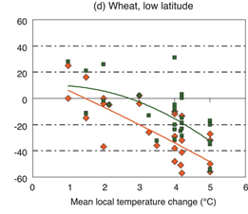
Cereal Production

Slide 6
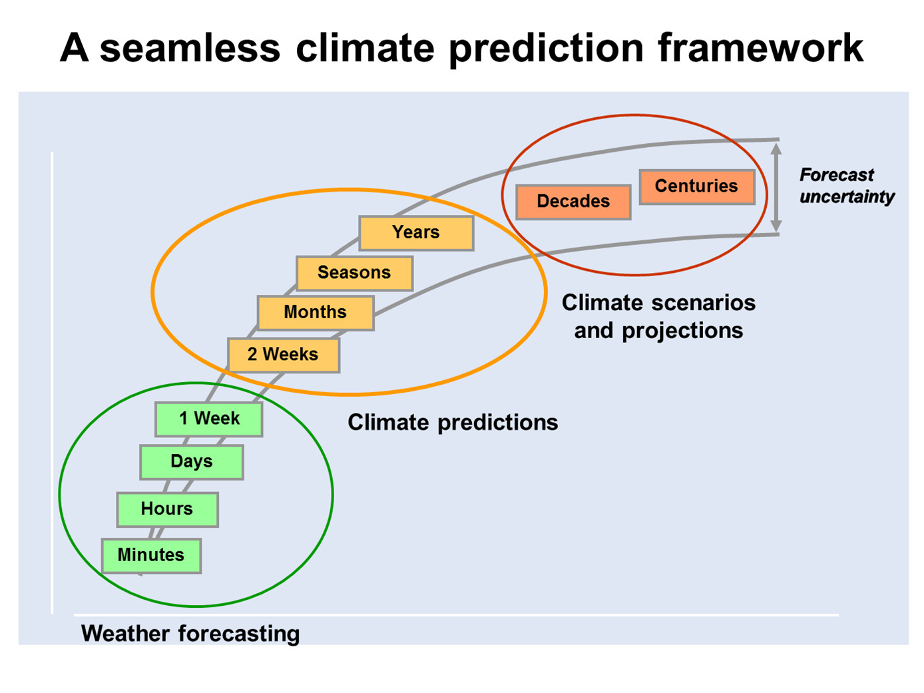
Climate Information can help, but….data is scarce…
Weather forecasts
Seasonal rainfall and temperature forecasts
Drought warnings
Crop forecasts
Long term forecasts
Onset/cessation?
Historical data

Slide 7
Climate data/information….
What is the story?

Slide 8
The Power of Stories
Once upon a time, there was a little girl named Goldilocks. She went for a walk in the forest. Pretty soon, she came upon a house. She knocked and, when no one answered, she walked right in. At the table in the kitchen, there were three bowls of porridge. Goldilocks was hungry. She tasted the porridge from the first bowl.
“This porridge is too hot!” she exclaimed…
Notes:
FOR PRESENTATION ONLY
Ask the audience:
Do you agree this is the beginning of a story?
What features are you using to make this judgment?

Slide 9
Now that’s a great story
But how do most climate scientists tell it….?

Slide 10
Like this…
Name | Species | Hair/Fur | Age | Appetite Level | Size | Preliminary Porridge Assessment | Preliminary Mattress Assessment
Goldilocks | Human | Blonde | 8 | Moderate | Petite | N/A | N/A
Papa | Bear | Brown | 12 | High | Big | Too Hot | Too Hard
Mama | Bear | Tawny | 11 | Moderate | Medium | Too Cold | Too Soft
Baby | Bear | Red-Brown | 3 | Low | Small | Just Right | Just Right
Notes:
FOR PRESENTATION ONLY
CLICK: Table appears
What do you think when you look at this chart? Do you simply digest the data? Or are you already looking for relationships, and ascribing meaning to those relationships? Are you looking for the “takeaway”? Are you not already relating this to a story you think you’ve heard before? Are you already telling the story in your head?
Is this a narrative?
Why or why not?
Not all written or oral communications are stories. Stories require specific features:
A world
A character
Tension
Action
Resolution
More generally:
Stories are linear
Stories make relationships explicit (e.g., cause-effect)
Stories link ideas to emotions
Stories deal with context much more explicitly than pure data: time and place matter

Slide 11
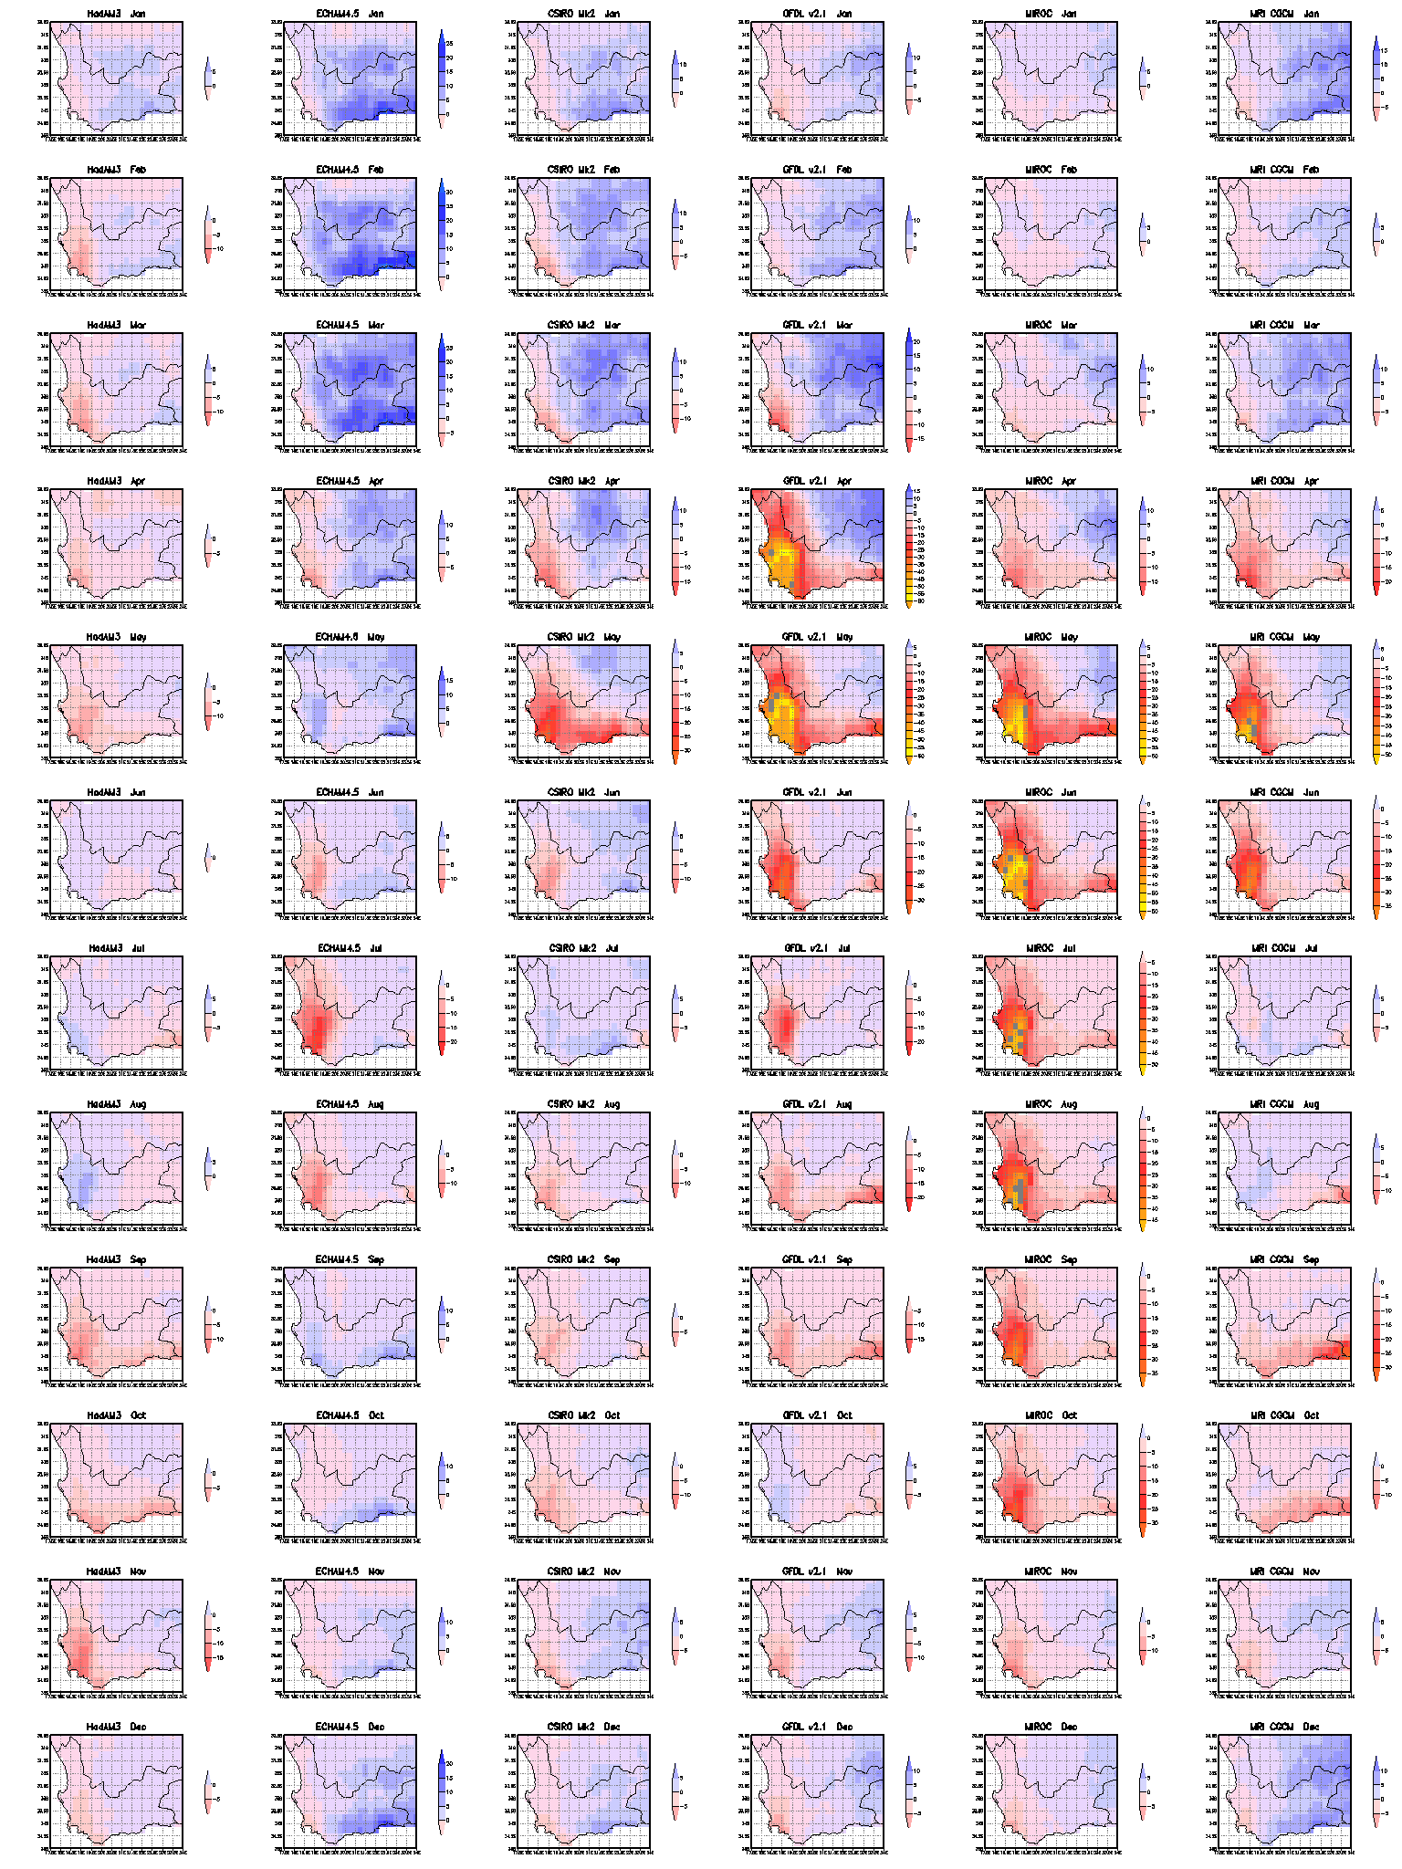
Jan
Feb
Mar
Apr
May
Jun
Jul
Aug
Sep
Oct
Nov
Dec
The Western Cape:
Projected changes in rainfall pattern and magnitude
Monthly Total
Downscaling to a 0.1º precipitation grid:
6 GCMs
SRES A2 forcing
Future – Control anomaly

Slide 12
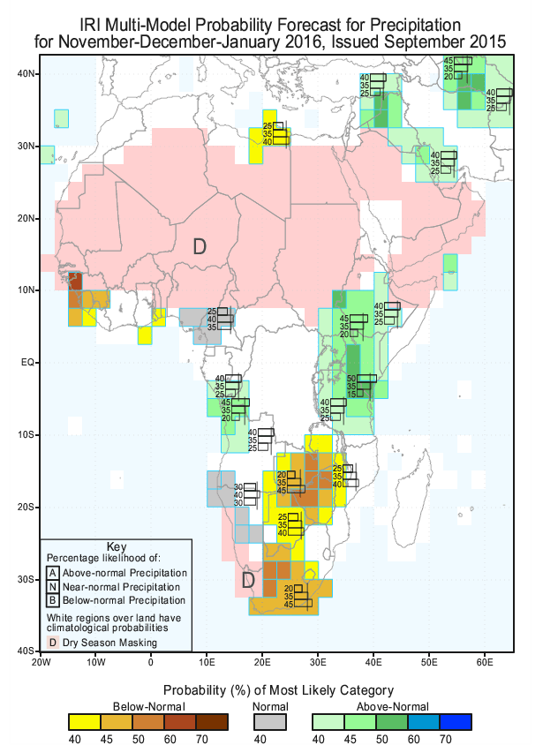
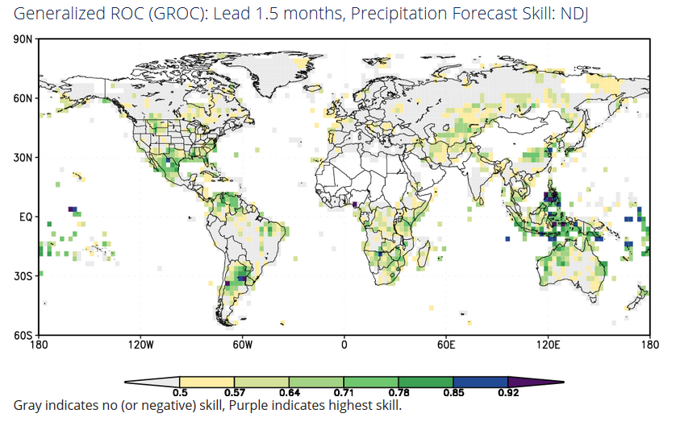
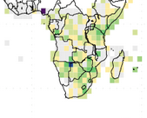

Slide 13
The useful message
Production of skilful forecasts
Wide dissemination of the products
Training in interpretation and application

Slide 14
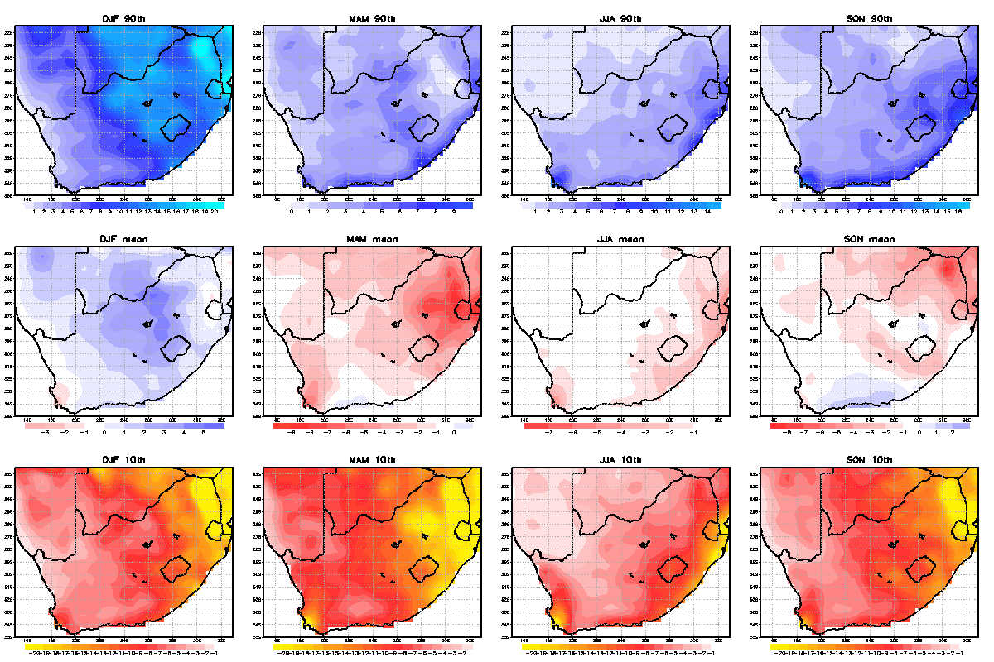
Rainfall anomalies 2040-2060 (mm per month)

Slide 15
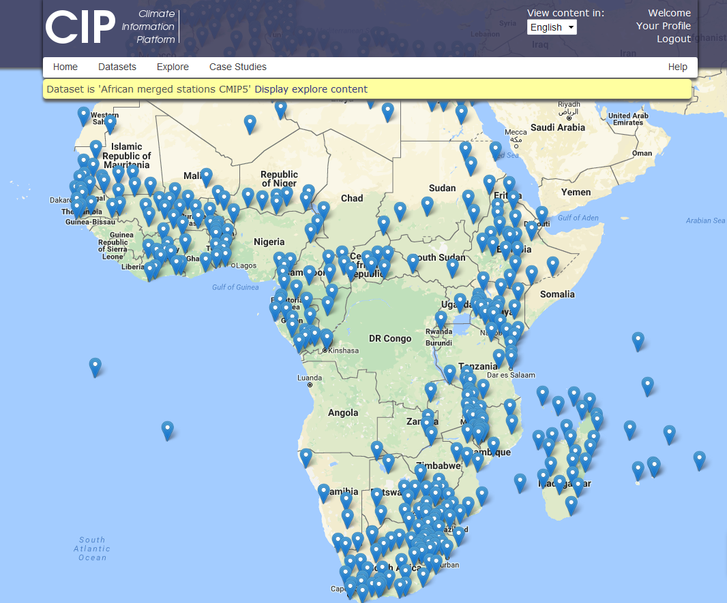

Slide 16
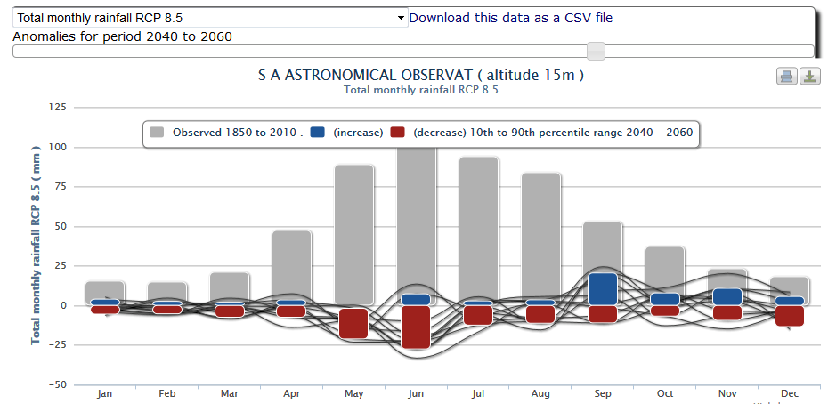
In context…rainfall

Slide 17
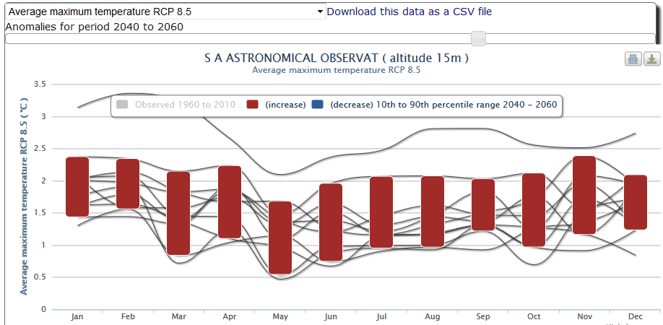
Temperature increases

Slide 18
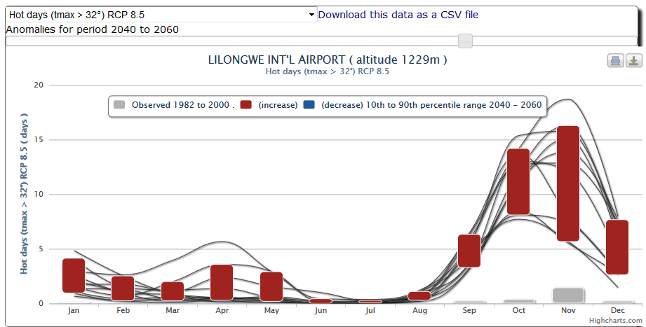
Hot days

Slide 19
The message (CC will affect CV!)
It’s (probably) going to get drier
Increasing temperatures increases evaporation
More intense rainfall, longer dry spells
More flooding
More frequent droughts
Relevance for Food Security:
Favourable conditions for Disease and Pests?
More extreme episodes
Water insecurity
Food insecurity (crop yield impacts)
Spoilage?
?????

Slide 20
The alarm bells
There is a dearth of useful climate information
Are there crop thresholds for temp/rainfall that will be breached more often?
How will the food/population/climate nexus respond to a changing climate in terms of exposure to more serious food security problems?

Slide 21
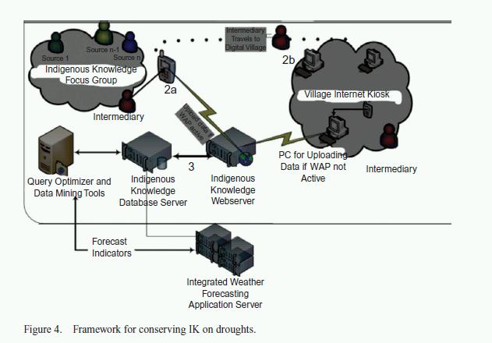

Slide 22
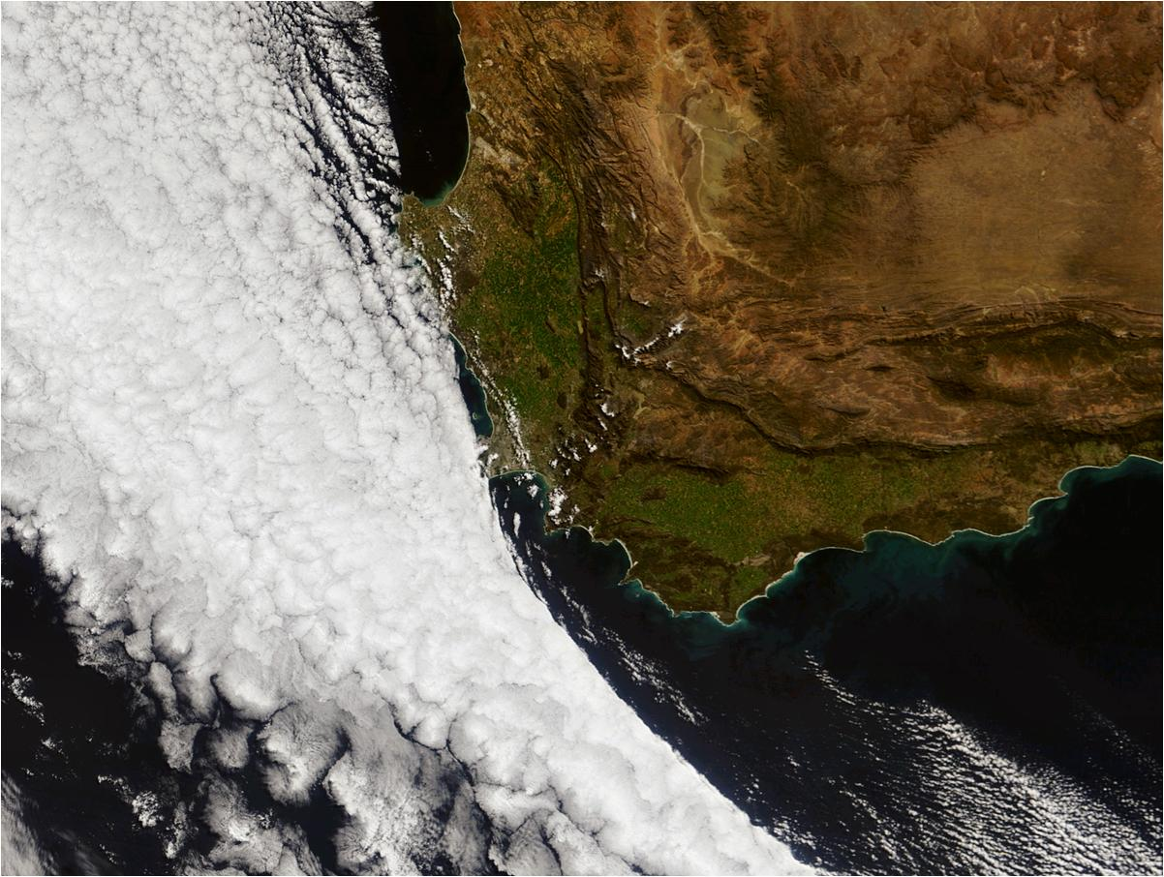
THANK YOU
peter@csag.uct.ac.za

