Slide 1
Priorities for African Australian international knowledge partnerships
Prof Cheryl de la Rey
5 September 2016

Slide 2
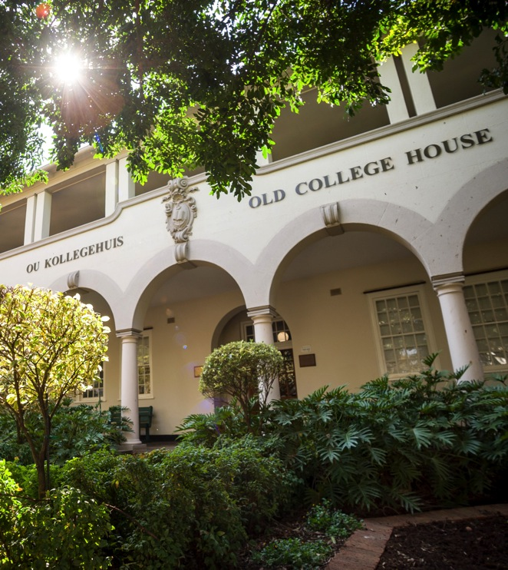
Overview
Sustainable Development Goals
AU Agenda 2063 - science and research priorities for Africa
Key to successful partnerships
Potential to grow the AAUN

Slide 3
SDGs

Slide 4
Sustainable Development Goals
Developed through wide ranging consultation with civil society and approved by all members of UN
Succeeds Millennium Development Goals (MDGs) applied to developing countries
SDGs = universal set of global goals to guide international sustainable development and transform the world
17 goals, 169 targets

Slide 5
Six essential elements for delivering
the sustainable development goals
(UN 2014)

Slide 6
Int’l Science Council (ICSU) review of SDGs
Major improvement over MDGs
Covers economic, environmental and governance dimensions of sustainable development
Applies globally
Scientific analysis by ICSU of SDGs and targets:
  Are they backed up by scientific evidence?
  Do they address all the dimensions of sustainable development in an integrated way?
  Are they specific enough to be implemented and monitored?

Slide 7
Issues
Consistency with existing international agreements and processes
  Success depends on alignment
Lack of integration will affect implementability
  Goals are interlinked - potential conflicts and trade-offs between targets – must be integrated
Measurability
  Many targets not quantified and no indicators to measure progress
  Availability of data, capacity to collect and measure
Not sufficiently developed

Slide 9
Recommendations
Overarching goal
New metrics to measure progress
  Successor(s) to GDP
Systems approach
  Develop interlinking targets common to several goals
  Emphasize synergies, enable trade-offs
Aggregate existing goals
  Clustering essential
Quantify targets and specify time frames

Slide 10
Science priorities for Africa

Slide 11
AU Agenda 2063: Priorities; 7 Goals
10-year development plan
Sustainable Inclusive Economic Growth
Human Capital Development
Employment Generation
Social Protection
Gender / Women Development and Youth Empowerment
Good Governance including Capable Institutions
Infrastructural development
Science, Technology and Innovation
Peace and Security
Culture, Arts and Sports

Slide 12
Goal 1: priorities
Goal | Priority Areas
(1) A High Standard of Living, Quality of Life and Well Being for All | Incomes, jobs and decent work Poverty, inequality and hunger Social security and protection including persons with disabilities Modern and livable habitats and basic quality services

Slide 13
Goals 2, 3 and 4: priorities
(2) Well Educated Citizens and Skills Revolution underpinned by Science, Technology and Innovation | Literate and skills revolution
(3) Healthy and Well-nourished Citizens | Health and nutrition
(4) Transformed Economies and Jobs | Inclusive sustainable economic growth Manufacturing / Industrialization and value addition Economic diversification and resilience

Slide 14
Goals 5, 6 and 7: priorities
(5) Modern Agriculture for increased Productivity and Production | Agricultural productivity and production
(6) Goal 6: Blue/Ocean Economy for Accelerated Economic Growth | Marine resources /industry Ports and marine transport Marine energy and minerals
(7) Environmentally sustainable Climate and Resilient Economies and Communities | Bio-diversity, conservation and sustainable natural resource management Water security Natural resources management Climate resilience and natural disasters

Slide 15
The power of partnerships

Slide 16
Rationale for collaboration
SDGs cannot be solved in isolation in our interconnected world
Nature, scale and complexity of socio-economic development problems require new approach
Effective solutions require convergence
  Integration of knowledge
  Inter-, multi- and transdisciplinary research
  Collaborative initiatives and partnerships across all social institutions
  Regional, national and international cooperation

Slide 17
“Nowhere is the need to address these grand challenges in a sustainable and socially responsible manner more acute than in developing economies, such as on the African continent, where the problems faced more often than not threaten the very existence and survival of large sections of the population.
Working together has, however, proved complex and challenging. To better understand and successfully navigate these challenges and complexities, it is important to recognise that scientific collaboration takes many forms.”
Extract from paper ‘The Power of Partnerships’ presented by
CM de la Rey in March 2016 in Zurich as part of ETH Global Lecture Series

Slide 18
Role of Higher Education
HE institutions have a crucial socio-economic developmental role in seeking solutions
Increased emphasis on social responsibility of HEIs
Cooperation, collaboration and partnerships essential to fulfil these roles

Slide 19
Trends in Higher Education
Unprecedented rise in academic co-authorships
Discernible move to inter-, multi and transdisciplinary research
Rise in regional, national and cross-border consortia - with other HE institutions, research bodies and communities served by institution, but also with government and industry (triple helix model)
Internationalisation of HE
Growing academic mobility (staff and students)
Merger of ICSU and ISSC in Oct 2016

Slide 20
Forms of collaboration
Most common: individual researchers working together, usually evidenced by co-authorships
Partnerships - typified by formal agreements, few partners and dense collaboration
Networks - characterised by loose and shifting interactions, can include individual researchers, universities, NGOs and funders
Koehn and Obamba conceptualised a collaboration continuum with partnerships at one end, networks at the other with a range of alliances in between

Slide 21
Collaboration in Africa

Slide 22
Trends in African HE
Growing participation rates in HE, especially in sub-Saharan Africa, but still much lower than developed economies
Student and staff mobility high in Africa, especially in SADC region which has highest outbound student mobility ratio worldwide (6%)
Mixed HE landscape
Growth in networks – RUForum, AAUN and ARUA

Slide 23
The problem of asymmetry
Patterns of collaboration between Africa and rest of the world suggest scientific and resource dependence
North-South collaboration is seemingly inevitably skewed and asymmetrical
  Emphasis on capacity-building
  African partners assist in fieldwork and data collection
  Low fractional count (proportionate contribution)
  for African partners

Slide 24
Mixed views
Mixed views about mobility of African students and academic staff
Double edged sword
African students and scholars pursuing opportunities out of Africa viewed as positive trend – home countries and the continent benefit from foreign experiences and expertise.
However, non-returning African students and staff deprive the continent of the critical human resource capacity needed for development
This ‘brain drain’ viewed as biggest challenge to African development.

Slide 25
AAUN: Case for continued collaboration
AU’s Agenda 2063 – the Africa We Want identifies the need for collaboration across social institutions as a non-negotiable prerequisite to address own national needs and problems in a sustainable way
Partnerships strengthens ability of African HE to impact on Africa’s socio-economic development
AAUN – record of success with limited funding

Slide 26
Keys to successful partnerships

Slide 27
AAUN: Successful collaboration for Development
Five principles for success
Shared mission
Constructive dialogue
Institutional support
Bridge research, policy and practice
Priority areas aligned with SDGs – food security and agriculture, education, mining and health (mother and child)

Slide 28
Opportunities and challenges for strengthening AAUN Partnerships
Achieve ‘near symmetry’
- Pre-partnership synchronisation
  Match academic strengths and emerging strenghts and capacity as well as institutional, regional and national needs of all partners
  Funding
  Translating research findings into policy outcomes
  Industry involvement

Slide 29
Goals 2, 3 and 4: priorities
(2) Well Educated Citizens and Skills Revolution underpinned by Science, Technology and Innovation | Literate and skills revolution Joint degrees
(3) Healthy and Well-nourished Citizens | Health and nutrition
(4) Transformed Economies and Jobs | Inclusive sustainable economic growth Manufacturing / Industrialization and value addition Economic diversification and resilience

Slide 30
Goals 5, 6 and 7: priorities
(5) Modern Agriculture for increased Productivity and Production | Agricultural productivity and production
(6) Blue/Ocean Economy for Accelerated Economic Growth | Marine resources /industry Ports and marine transport Marine energy and minerals
(7) Environmentally sustainable Climate and Resilient Economies and Communities ADD: Governance, human rights and social justice | Bio-diversity, conservation and sustainable natural resource management Water security Natural resources management Climate resilience and natural disasters

Slide 31
Priorities for AAUN Partners
Building interdisciplinary knowledge to address SDGs – T-shaped researchers
Expanding modalities and focus areas of partnerships
Research; Joint academic programmes and Policy engagement

Slide 32
Thank you

Slide 33
Chapter heading
Subheading

