Slide 1
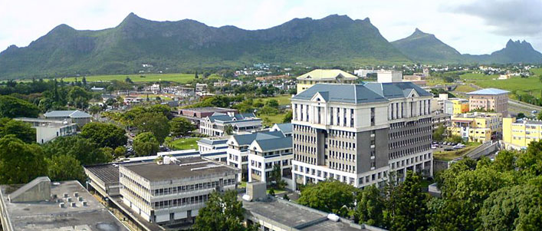
The Role of Higher Education in Achieving Sustainable Development Goals
A Case Study of the University of Mauritius
FORUM & AGM
Professor (Mrs) Romeela Mohee, CSK, FRSC(UK), FMAST
Vice-Chancellor
University of Mauritius
Monday 5th September 2016

Slide 2
Higher Education & Sustainable Development Goals
Challenges for African economies
High poverty rates
Environmental impact and Degradation
Rapid Population Growth
Urbanisation (waste disposal)
Deforestation
Challenges for HEIs
Critical shortage of quality faculty
Limited capacity of governance
Inadequate facilities and infrastructures
Problems of quality and relevance of teaching and research
Limited capacity of research
Meeting increasing demand for equitable access

Slide 3
HEIs and SD
RIO Earth Summit – Agenda 21
Promote and improve the quality of education
Reorient the curricula
Raise public awareness and understanding
Train the workforce
HEIs as Agents of Change
Model sustainable practices for society
Skills of integration, synthesis, and systems-thinking
Inspired, real-world problem-based research to address sustainability challenges
Promote and enhance engagement between individuals and institutions

Slide 4
HEIs and UN SDGs
HEIs have a Major role to play
Access to Quality Technical, Vocational and Tertiary education
Eliminate Gender disparities in Education and ensure Equal Access to all levels of Education
Empowerment of Women and Gender Equality
Promote sustained, inclusive and sustainable Economic Growth and Productive Employment
Substantially reduce the proportion of youth not in employment
Enhance scientific research, upgrade the technological capabilities of industrial sectors and encourage Innovation

Slide 5
HEIs as Agents of Change
Drivers in Teaching*
Global citizenship
Environmental stewardship
Social justice, ethics and wellbeing
Futurethinking
Drivers in Research
Impact of Research
Orientation
Research Uptake
Engagement with stakeholders
Three Pronged Approach
Meeting the Targets of SDGs
Building Evidence-base for Policy-making
Developing Strong Relationships with all Stakeholders
*Education for sustainable development, June 2014 Report for UK HE Providers

Slide 6
Teaching in Action
2015 marked the end of the United Nations Decade of Education for Sustainable Development
Climate Change
Impact Analysis performed on Climate Change
Socioeconomic Perspective and Insights for Policymakers
Assessing effects of Sensitisation Campaigns concerning Climate Change
Green Economy Scoping studies and implementation of Green Campus
Medicine
Effective data access models developed for immediate implementation
Education strategies on medicines
Provision of Continuous Medical Education (CME) through the Medical Update Group
Investigations into the use of Traditional and Alternative medicines in the Local context for Consumer
Trade
Analysis of Resource Efficiency in Mauritian Textile Sector for Sustainability Challenges
Insight of Debt Repayment Capacities of Developing Countries,
Export Diversification And Economic Growth; The Case Of SADC
Trade and Environmental Impact Studies-Case Specific Analysis

Slide 7
Areas of Intervention The Mauritian-African Context
ICT
Exploratory Studies on New Media Influence on Youth
Impact Analysis of ICT tools on new generations
On Campus implementation of broadband Internet and high-tech Communication tools
Evaluating Technology as a tool for Sustainable Development with policy-oriented recommendations
Ocean Economy
Monitoring for Environment and Security in Africa; Drawing up policies and development plans for Sustainable development
Use of Earth Observation Technologies in Disaster management
IAEA-UNESCO Project on Submarine Groundwater Discharge in Coastal Zones in Mauritius
Exploration And Sustainable Exploitation Of Deep Sea Minerals In The EEZ And ECS Of Mauritius
Tourism
Dynamic Economic Impact Of Tourism For Island Economies
Development of a Community Support Model For Tourism
Factors Influencing The Sustainability Of The Mauritian Tourism Industry
Assessment of Environmental Impact of Tourism

Slide 8
UoM Strategic Plan 2015-2020
Measure enumerated to bring about Change
Triple bottom line taken into consideration
Introduction of General Education Modules
Broaden knowledge of Students on themes such as Globalisation, Entrepreneurship, Understanding Society etc.
Research themes relating to SD
Climate Change
Food Security
Biodiversity and Conservation
Renewable Energy and Energy for Sustainable Development
Gender Issues in Entrepreneurship
Ethics and Corporate Social Responsibility
Sustainable Tourism
Human Rights

Slide 9
Upgrading of Facilities
Use of Photovoltaic Plates
66 Wi-Fi Access Points
Broadband internet connected on Fibre Optic
Implementing Paperless for a Green Campus
Setting up of new faculties
Faculty of Ocean Studies for sustainable use of Marine resources
Faculty of ICT in the pipeline

Slide 10
UoM Research & Community Engagement
Knowledge Transfer Office
Launched in April 2016
Vehicle for Research Uptake and Community Engagement
Engaging Industry, Government and the Community at large
Better address needs of Stakeholders
Participation in DRUSSA and HERANA Project
Strengthened partnerships with Private Sector firms and Parastatal Bodies
Active engagement of NGOs and Community Orgs in University Dialogue Meetings
Yearly UoM Research Week
Showcasing of Research Portfolios and findings
University grounds dedicated exclusively for the event for 5 days
Participation of Students and Researchers at all levels, with the presence of external stakeholders such as NGOs, Govt, Private Sector firms etc.

Slide 11
To Promote University-Community Partnerships
Staff members encouraged to undertake community outreach activities
Include local stakeholders in teaching and research agendas.
Creating broad public awareness
Recognition and rewarding achievements in community engagement activities.
Allocation of funds to Faculties community engagement activities.
Faculty-generated funds will be ploughed back into the Faculty for Research Uptake activities
Regular monitoring of research uptake through KPIs and OVIs
Partnerships with national, regional and international agencies.
Regularly providing information to KTO on community initiatives

Slide 12
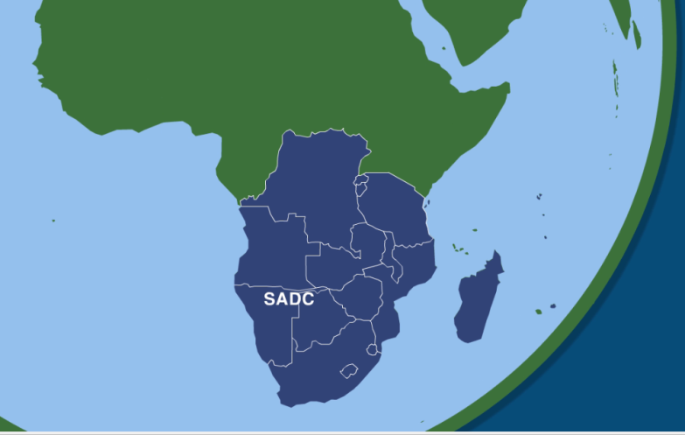
Disaster Management and Monitoring; A Case Study
Monitoring for Environment & Security in Africa (MESA)
Purpose of the MESA Project
To use Earth’s Observation Data and Technology to support African decision makers and Planners in drawing up National, Regional and Continental Policies and Development Plans aimed at Sustainable Development.

Slide 13
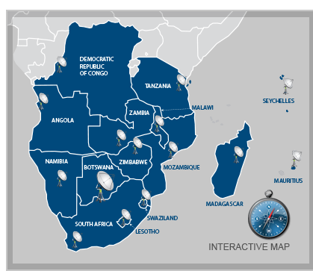
MESA – In Short
Quick, Complete. Unbiased information from the Earth’s Observation Satellite,
Needed to support Planning and Decision Making,
For better management of Agriculture & the Environment,
At a time when all are threatened by climate change impacts.

Slide 14
HEIs, SDGs and Tourism
Higher education institutions offering tourism programs should recognize the role of tourism in achieving the SDGs.
Appropriate funding for Research and other resources
Tourism has the potential to be a tool, or can represent a partial solution, for poverty reduction as well as ensuring environmental sustainability, and the empowerment of women and girls.
Especially in the developing world, increasing tourism demand is seen to be economically beneficial,
Due to the new global-scale role, tourism has become an important social policy tool for community development providing jobs and economic benefits for the poor and previously disadvantaged people

Slide 15
World Trade Organisation Chairs Program (WCP)
Strengthen the human and institutional capacities of universities from developing countries to support governments in the formulation of sound trade policies.
WCP Mauritius
Organised a number of International Conferences on Issues related to Regional Integration, Non Tariff Measures and Trade in Services
Organised a number of speaker series on various aspects of Trade including both the economic and legal implications
Published papers on trade related issues
Published book chapter on export diversification and trade facilitation

Slide 16
MSc Social Protection Financing
Aims of the Program
Improving the overall understanding of social security
Analysing and developing strategies to enhance the effectiveness of social security systems and
Raise awareness and mobilise key actors and resources with a view to improving both the quality and coverage of social security.
More than 130 officials from the Government and Private social security funds from more than 14 countries in Africa have been trained under this Program. More than one third were women.

