Slide 1
Gender Equity in Africa: Intersection of Research, Training and Capacity Building
PRESENTERS:
Professor Prem Ramburuth (UNSW)
Dr Melody Mentz-Coetzee (UP)
Associate Professor Nasima Carrim (UP)

Slide 2
Intersection & Networks in Current Gender Projects in Africa
Gender Equity in Africa
PERKA study of postdoctoral fellowships in Africa
IGD, UNSW Transformative Academic Development and Research Training
PDRF 2: Women early career researchers in food systems in Africa: research training and capacity building
PRDF 1: Empowerment in the Workplace: Women in Africa
Food Systems Research Network for Africa (FSNet-Africa)
PLuS Alliance, Establishment of PhD Training Institutes

Slide 3
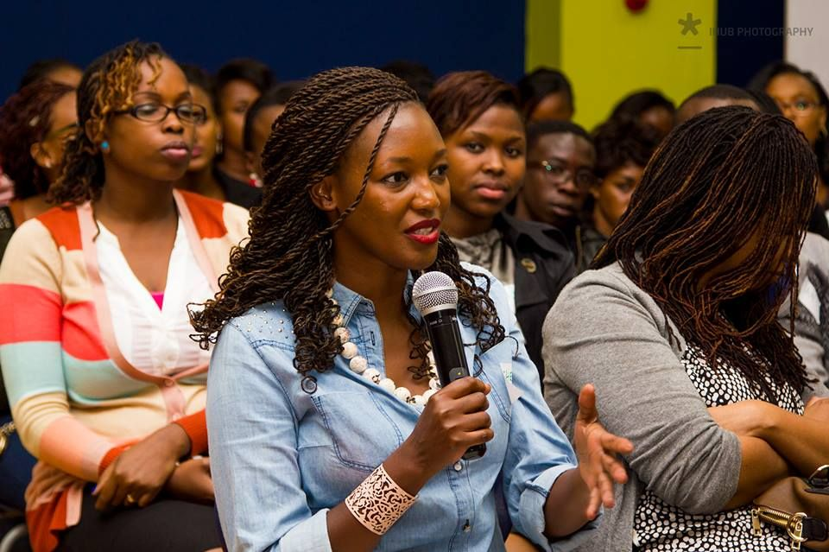
PRDF 1: Empowerment in the Workplace: Women in Africa
Team Members:
Prof Prem Ramburuth (Lead) UNSW Sydney
Dr Olayide Ogunsiji (Co-Lead) WSU
A/Prof Nasima Carrim UP, South Africa
A/P Abimbola Oluwatosin Uni. of Ibidan, Nigeria
Ms Julaina Obika Gulu Uni., Uganda
Ms Clara Kansime (ECR) Gulu Uni., Uganda
v

Slide 4
Empowerment in the Workplace: Women in Africa
Focus:
Identifying the perceived and real barriers for women in the workplace in Africa and how they can be empowered to reach their career aspirations
Sample
Surveys: 618 Interviews: 60
Countries: Uganda, South Africa, Nigeria
Gender: Female (441), Male (177)
Formal sector: Business, Health, Education, Agriculture, Tourism, Own Businesses
Some Demographics
Work status: Full-time roles 89.5%
Highly Educated workforce: 72% Bachelors Degree
Majority age group 25-49 years: 75.3%

Slide 5
Empowerment in the Workplace: Women in Africa:(Quantitative Data)
Empowerment in the Workplace
Women are recognised for their work & expertise 70%
Women have access to career development 72%
Women feel supported by workplace policies 61%
HR Perspectives
Satisfied with work & roles: 67.5%
Not satisfied with pay: 62.9% BUT
Believe men & women receive equal pay: 72.7%
Men hold more senior positions: 57.8% BUT
Prefer to have more women supervisors: 66.8%
Women listen to others’ view (empathy): 60.7%
Women are better communicators:
Yes 56% No 26%
Socio-cultural Barriers
Women face more barriers in their careers: Yes 48%, No 52%
Sociocultural pressures & expectations in dual role of women: 62%
Family responsibilities hinder women’s work performance: Yes 53%, No 29.3%

Slide 6
Empowerment in the Workplace: Women in Africa (Qualitative Data: Common themes )
Traditional versus changing gender roles (including gendered futures and aspirations)
Targeting and questioning female leadership
Gendered Spaces - allocating gender specific responsibilities to men and women
Reflections on organizational culture and practices
Gender and labour policies (extent of implementation and impact)
Sexual Harassment
Workplace Romance and Promotions
‘Virtuous Women’ (forced to select either family or career, plus community engagement)
Work life balance and the impact of culture on women in the workplace
Notes:
Thank you Prem. From the qualitative data collected in Nigeria, Uganda, South Africa and Kenya, based on male and female managers’ responses, the following common themes emerged in the different contexts.
Themes were clustered in terms of interrelated areas that attracted our interest, formed the basis of our discussion at our meetings and will set the directions for our papers.
Specifically, the first dark blue cluster looks at areas of gendered roles, how they have been allocated and how they may be changing (recall slide 4 most women are satisfied with their work conditions-HR perspectives). The green cluster is the organization culture and policies. We will focus on the extent to which labour policies are enforced in Nigerian, Ugandan, South African and Kenyan organisations to ensure gender parity.
The third cluster (light blue) is about sexual harassment and the area of how women are perceived in the workplace and these themes are linked to cultural behaviour. We believe that these themes would make a contribution in the gender and management literature and would lead to sharing of knowledge through the various publications

Slide 7
PRDF 1: Empowerment in the Workplace: Women in Africa Publications in Progress
Title | Journal
Perceived and real barriers for women employed in the formal sector in Africa | Gender, Work and Organization | (A)
Empowerment, leadership and the impact of female supervisors in the workplace | Human Resource Management Journal | (A)
Gendered Spaces: Allocating gendered roles for men and women (qualitative article) | Gender and Society | (A)
Gender, cultural norms and expectations: Implications for the workplace | Gender of Social Issues | (A)
Gender issues across cultures: A comparative analysis of Uganda, Nigeria and South Africa | World Development African Development Review | (A) (C)
Notes:
We have also identified different A-rated management and gender journals for the various articles that we intend to target for our publications. We looked at the aim of the specific journals and the preferred methodology and how our articles may fit in with these journals. We are for example going to target Gender and Society for our article entitled Gendered Spaces: Allocating gendered roles for men and women, which will be a qualitative article.
I hand over to Melody for the second PRDF

Slide 8
PRDF 2: Women Early Career Researchers (WECRs) in Food Systems in Africa: Research Training and Capacity Building
Team Members:
Professor Prem Ramburuth and
Dr. Melody Mentz-Coetzee

Slide 9
Aims and Approach of the Project
(a) Investigate the extent to which Women Early Career Researchers (WECRs) in Africa are engaged in the area of Food Systems
(b) Select a pilot group of 10 WECRs working/studying in the area of Food Systems
Input on selection from entities including ARUA, ARUA Centre of Excellence in Food Security (UP), Gulu University (Uganda) and other networks in Africa
(c) Conduct online interviews and group discussions, to investigate the career paths of the WECRs, better understand their aspirations, challenges, requirements for research support and relevant disciplinary area/s for capabilities development
(d) Provide workshop training online, drawing from UP, UNSW, AAUN & networks in Africa:
Workshop 1: Research Training and Modules to provide targeted training to overcome challenges encountered by WECRs;
Workshop 2: ‘Train the Trainer’ and Academic Leadership Development with modules to prepare the WECRs to train other women researchers, provide leadership and establish a cadre of researchers in Food Systems in Africa.

Slide 10
Moving Forward (2021)
COVID-19 has caused significant delays in the project – but project activities will resume shortly to prepare for engagement with Early Career Researchers in early 2021.
The pandemic has highlighted two key issues that bear direct relevance to the project.
Food and nutrition security came under further threat as responses to the pandemic were implemented. Clearly demonstrated the need for improved resilience and transformation of African food systems.
Women have been disproportionately negatively affected by the
pandemic, including within the research system.
It is critical to ensure that the long-term impact of the pandemic does not further disadvantage aspiring young female food systems researchers.

Slide 11
Thank you!

