Slide 1




Nutrient density and protein quality of African processed meat products
Hettie C Schönfeldt, Leshi Oluwatosin, Mieghan Bruce, Beulah Pretorius
AAUN Australia Forum
Online via Zoom
2 November 2020

Slide 2
Background
Meat and meat products are nutrient-dense foods - protein and a wide range of vitamins and minerals
Meat consumption is associated with socio-economic status and people aspire to consume it on a daily basis
Economic constraints and cultural preferences contribute to different food choices
Increased cost of living in urban environments forces many to consume cheaper alternatives
Ready-to-eat processed meat products forms a significant part of the diet
It can be attributed to their lower cost, versatility, extended shelf-life and availability on the market

Slide 3

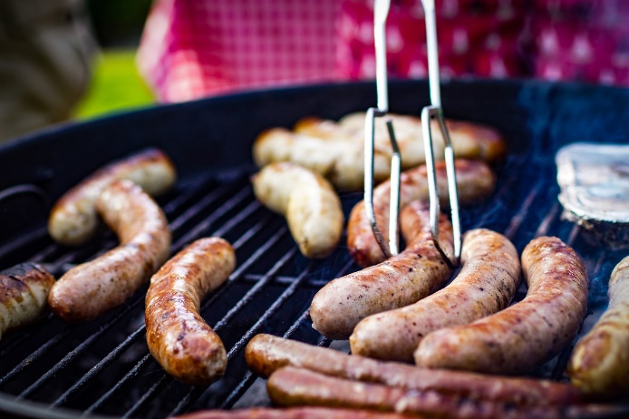
Background
Processed meat is defined as
“meat that has undergone any action that substantially altered its original state (including, but not limited to, heating, smoking, curing, fermenting, maturing, drying, marinating, extraction or extrusion or any combination of all these processes),
but excludes raw processed meat”

Slide 4

Average consumption of meat in South Africa
per capita/day consumption, 2014
(Schönfeldt & Pretorius, 2016; based on BFAP per capita consumption data for 2014)

Slide 5
Average consumption of processed meat per day
Intake data of IMS members, updated October 2018

Slide 6
Study Objective
1
To determine the nutrient composition of processed meats commonly consumed
3
Evaluate the nutrient density and protein quality of the processed meat products
Inspect current nutrient data available in African food composition tables
2

Slide 7
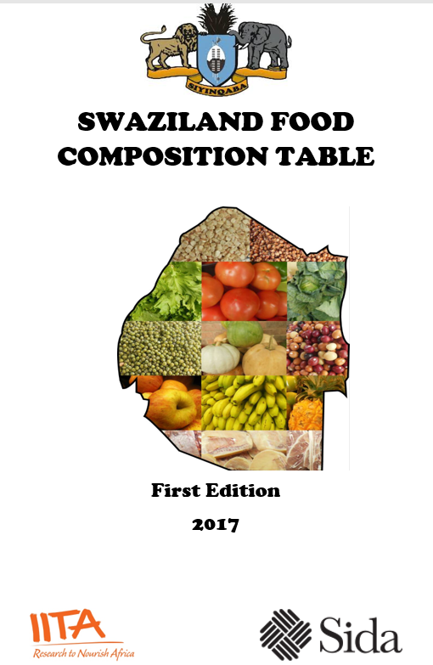
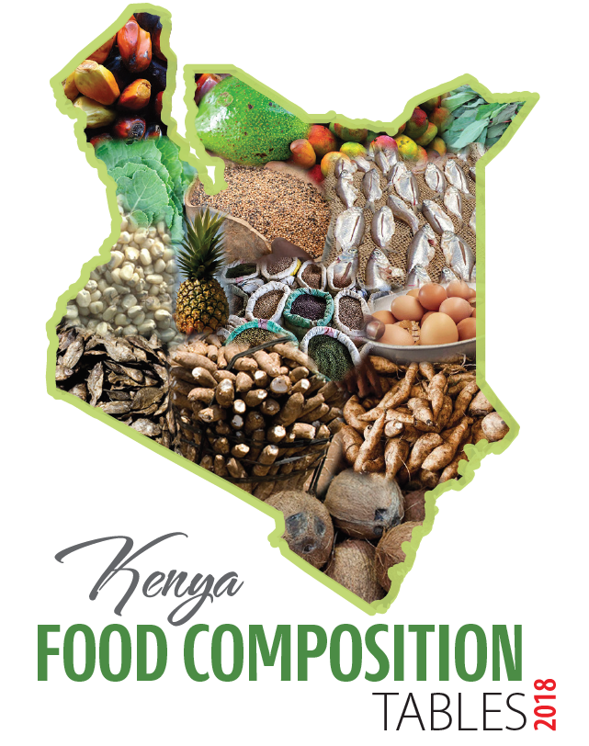
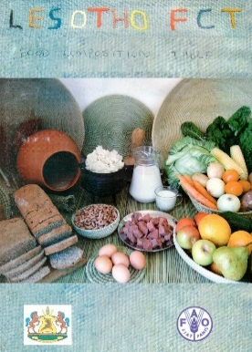
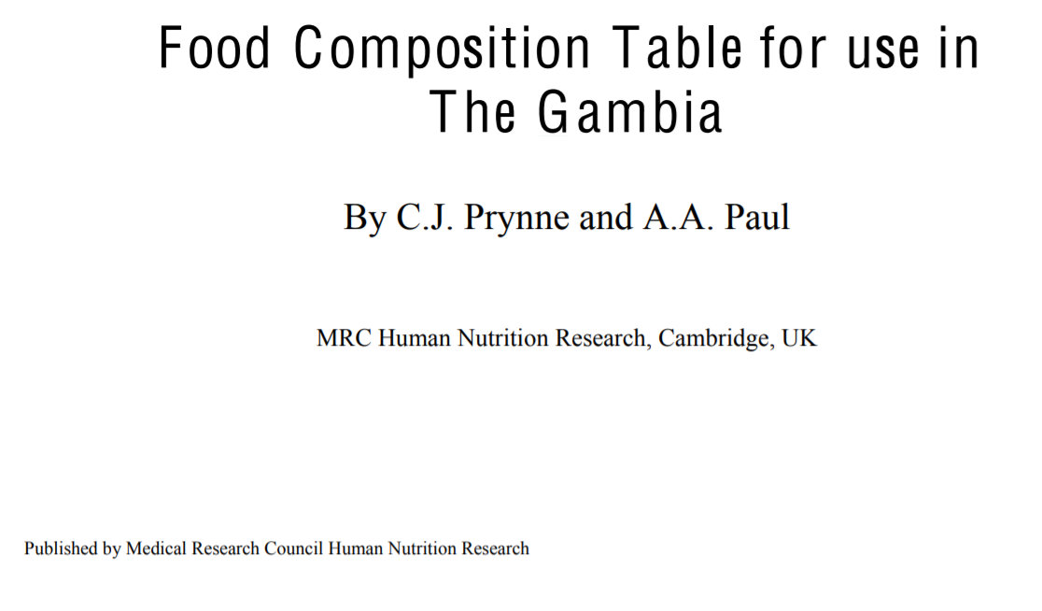
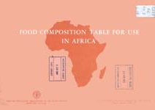
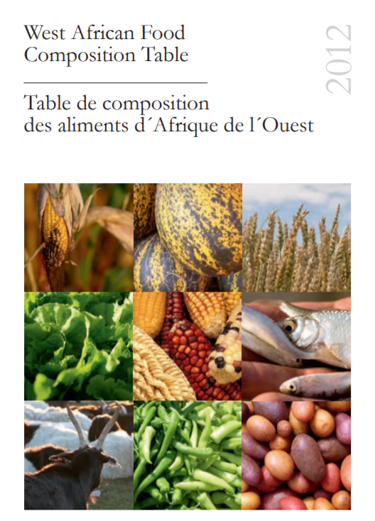
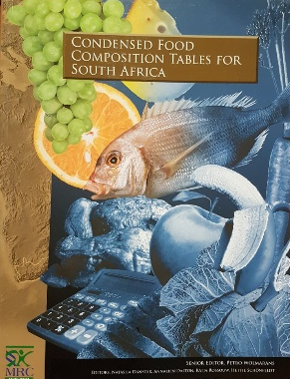
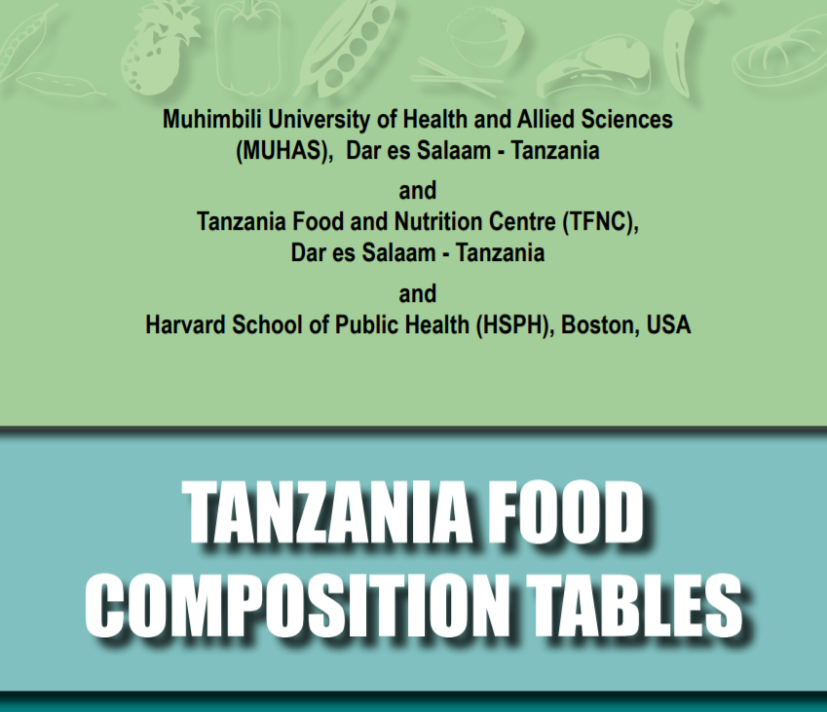
African Food Composition Tables
20 Food Composition Tables
  6 Countries
    Gambia, Kenya, Lesotho, South Africa,
    Swaziland, Tanzania
  2 Regional
    Africa, West Africa
Notes:
The new Nigerian food composition table did not list any data for processed meat products.

Slide 8
African Food Composition Tables
Gambia | - | Corned beef, canned (Aid Food)
Kenya | - | Beef sausage, Frankfurters, Liver sausage, Pork sausage
Lesotho | - | Polony
South Africa | - | Corned beef, Frankfurters, Ham, Luncheon meat, Peperoni, Polony (Bologna), Salami/Russians, Beef sausage, Pork sausage, Canned viennas
Swaziland | - | Bacon, Ham, Polony, Pork sausage
Tanzania | - | Sausage
Africa | - | Sausage, unspecified
West Africa | - | Wiener sausage (canned)
Main source of data: USDA & McCance and Widdowson’s

Slide 9
Processed Meat Legislation
Processed meat products should comply with a vast array of requirements as stipulated in various acts, regulations and specifications
South Africa
  R.127 Regulations relating to trans-fat in foodstuffs of 11 February 2011
  R.214 Regulations Relating to the Reduction of Sodium in Certain Foodstuffs and Related Matters of 20 March 2013 with amendments [No.1071 of 6 October 2017 and No.812 of 31 May 2019 - Amendments to R.214]
  R.1283 Regulations Regarding the Classification, Packing and Marking of Processed Meat Products intended for sale in the Republic of South Africa of
  4 October 2019
Nigeria
  Legislation on processed food exists with little emphasis on processed meat
  The Counterfeit and Fake Drugs and Unwholesome Processed Food Act No 25 of 1999 (now Counterfeit & Fake Drugs and Unwholesome Processed Foods (Miscellaneous Provisions) Act Cap C34 LFN 2004
  Regulation through National Agency for Food and Drug Administration and Control (NAFDAC) - food safety and quality
Notes:
The Regulations relating to trans-fat in foodstuffs (R.127), the sodium reduction regulations (R.214) and the regulations governing processed meats requiring a minimum meat content in manufactured meat products (R.1283) will have the most pronounced effect on the reformulation and compositional requirements for processed meat. With the legislation (R.1283) coming into effect in April that will reduce the protein content of “meat” products by 20%, concerns are raised that this could hit the poor who would be paying the same price for less nutrition.
NAFDAC is the lead agency for food safety and quality in Nigeria

Slide 10
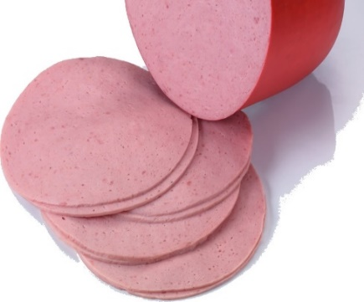

Conclusions
Nutrient data from all the processed meat products, none were from African origin
Processed meat is not a homogenous food group
Important to study dietary quality for processed meat categories and to inform and develop appropriate food-based dietary guidelines to improve nutrition outcomes at country and regional level
Polony
Bologna

Slide 11


Acknowledgements
Thank you
hettie.schonfeldt@up.ac.za

